Slide 1
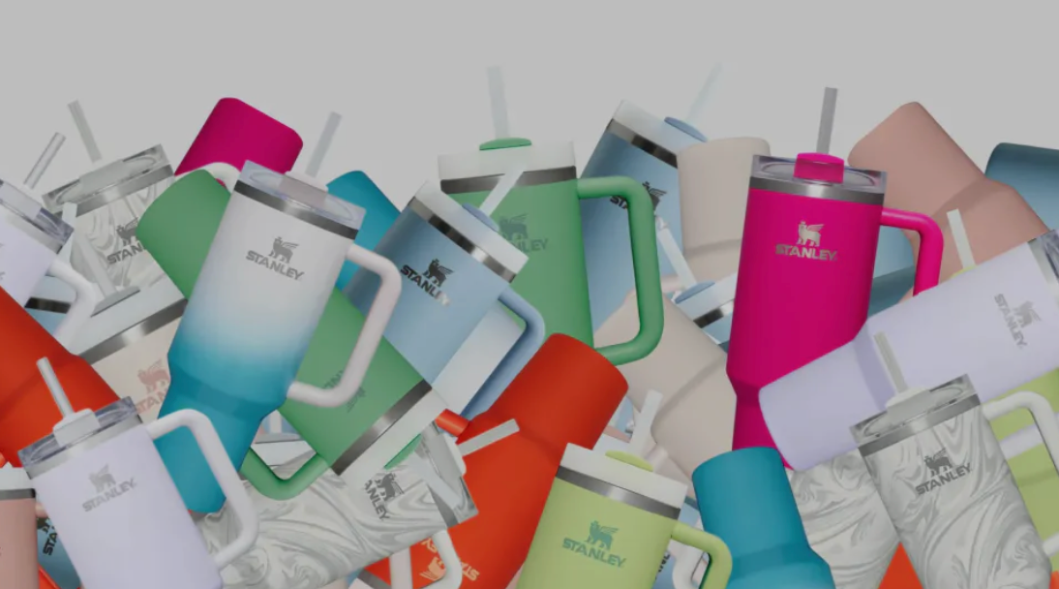
STANLEY CUP CRAZE
PRESENTED BY GROUP 7
Carmen, Jenny, Crystal, Israel

Slide 2
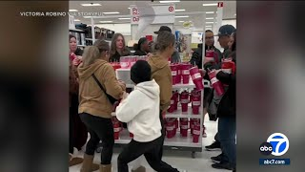
As reported on ABC¹
Notes:
How has the influencer market impacted the searches for Stanley?
Using line graphs
Talk about the viral videos

Slide 3
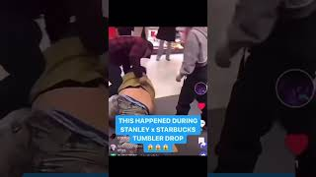
As reported on Youtube³

Slide 4

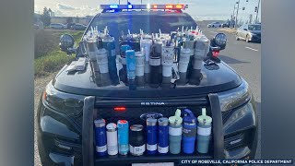
As reported on ABC7 News ⁴

Slide 5
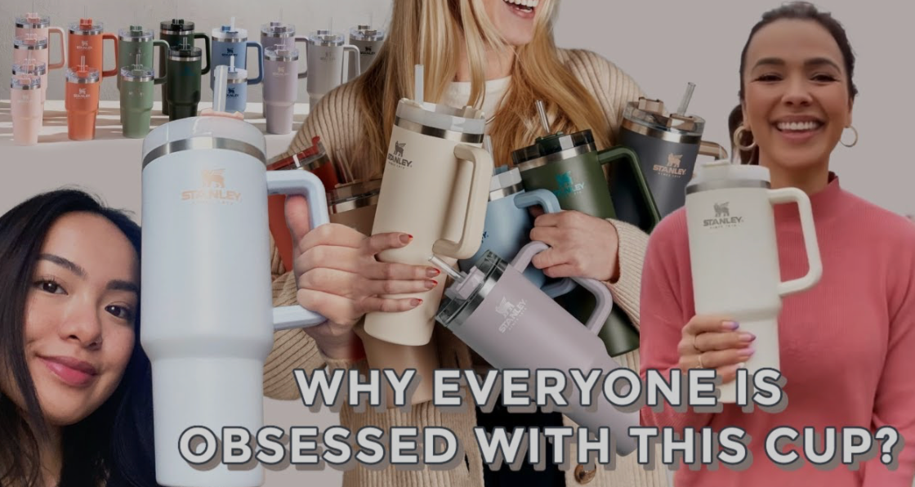
Why is everyone obsessed with this cup?
Notes:
Should say “Why IS everyone obsessed with this cup?” – “is” and “everyone” just needs to be reversed

Slide 6
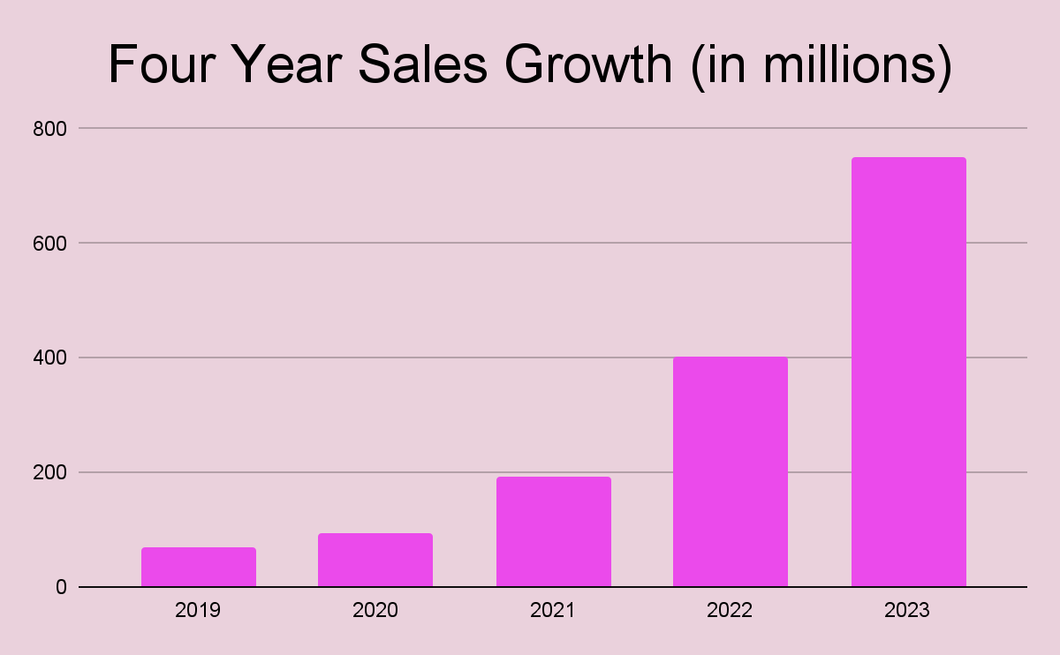
SALES GROWTH FROM 70 TO 750 MILLION
As reported by Forbes⁵
Notes:
“Stanley revenue jumped tenfold from $74 million in 2019 to $750 million in 2023, largely thanks to the viral success of its Quencher bottles” – according to Forbes staff reporter, Conor Murray
Conor Murray Water Bottle Brands Compete For Attention On Social Media—As Hydro Flask Takes Shots At Stanley Over Lead Concerns
Jan 31, 2024,04:35pm EST
https://www.forbes.com/sites/conormurray/2024/01/31/water-bottle-brands-compete-for-attention-on-social-media-as-hydro-flask-takes-shots-at-stanley-over-lead-concerns/#:~:text=Tangent,Target%20have%20also%20gone%20viral.

Slide 7
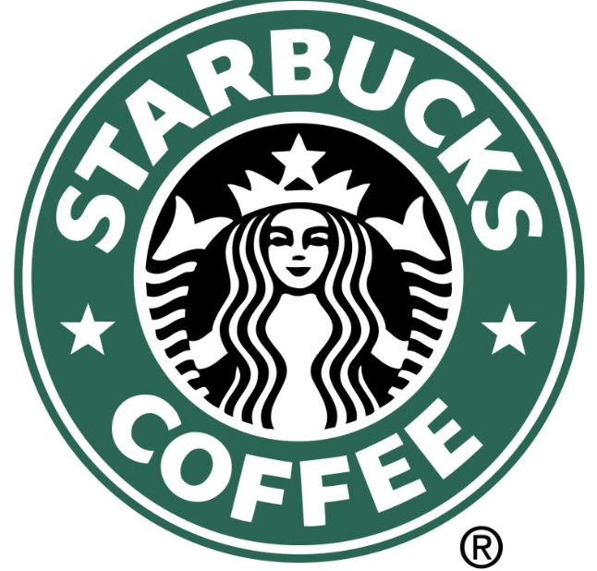

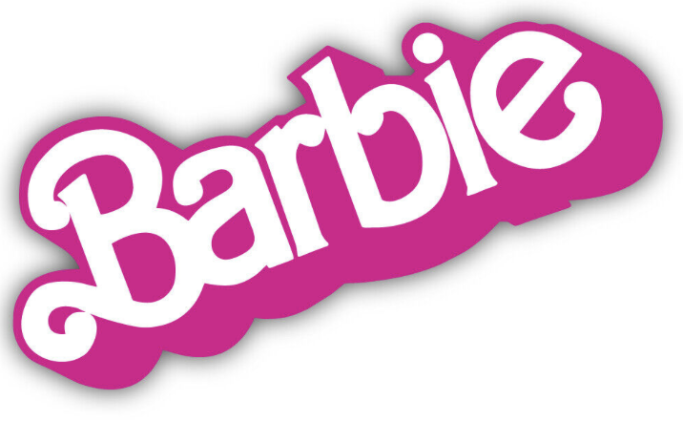
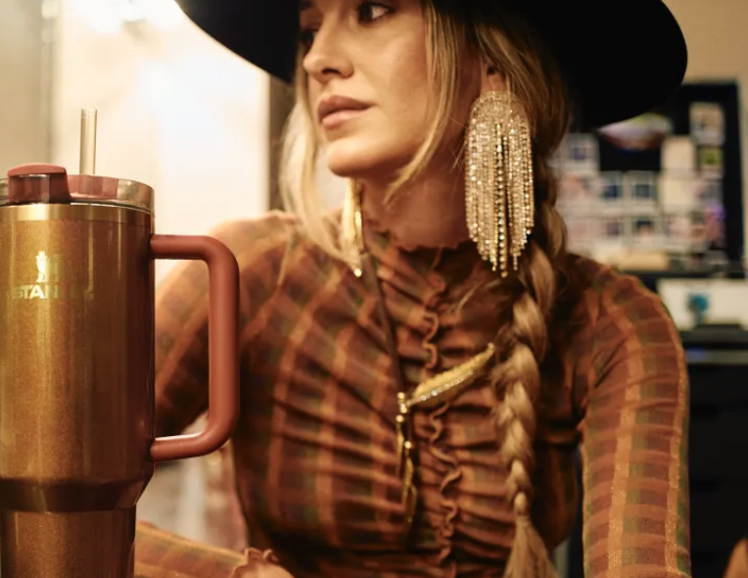
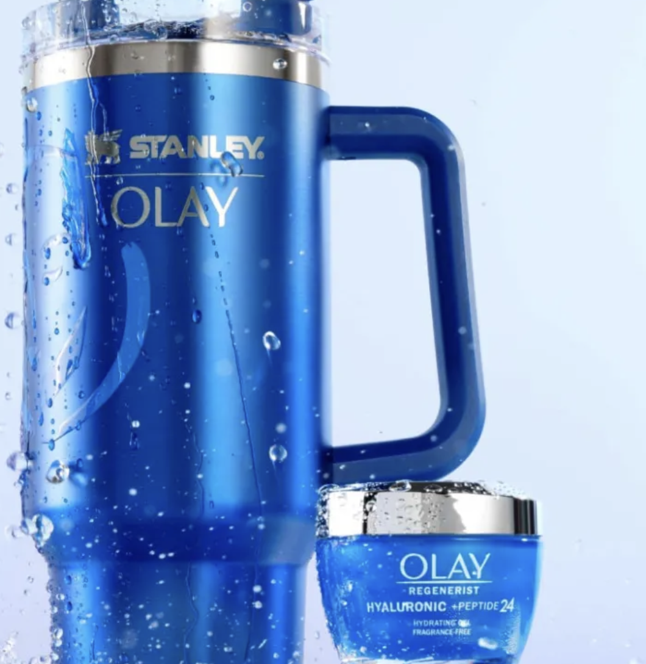

THE POWER OF SOCIAL MEDIA
By appealing their now best selling product, the Quencher Tumblr, to women and utilizing cross marketing opportunities with collaborations, the 100 year old Stanley Brand has over 900 million hashtag views.

Slide 8
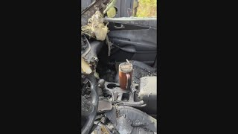
THE VIRAL VIDEO
posted 11/15/23
username: @danimarielettering¹
currently at 96.9m views as of 09/18/24

Slide 9

the 110+ year old company that went Mega-Viral ⁸

Slide 10
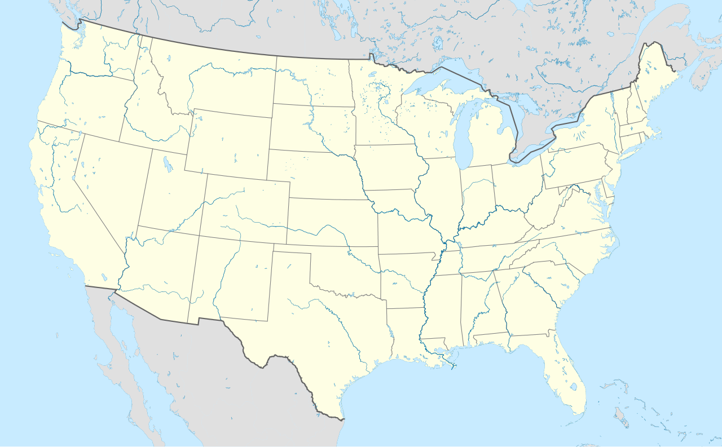
Where in the US do people search for Stanley tumbler the most?

Slide 11
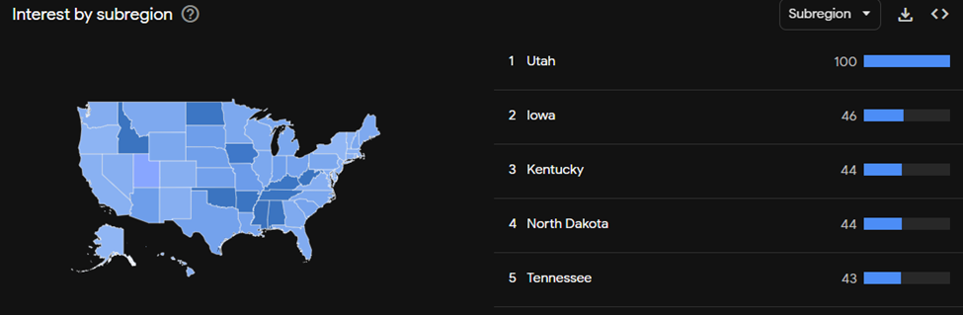

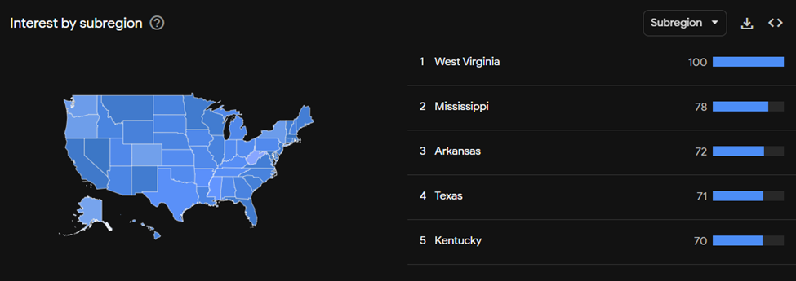
20 years ago
Overview of Stanley Interest
(By Region)
5 years ago
12 months ago
Notes:
Stanley

Slide 12
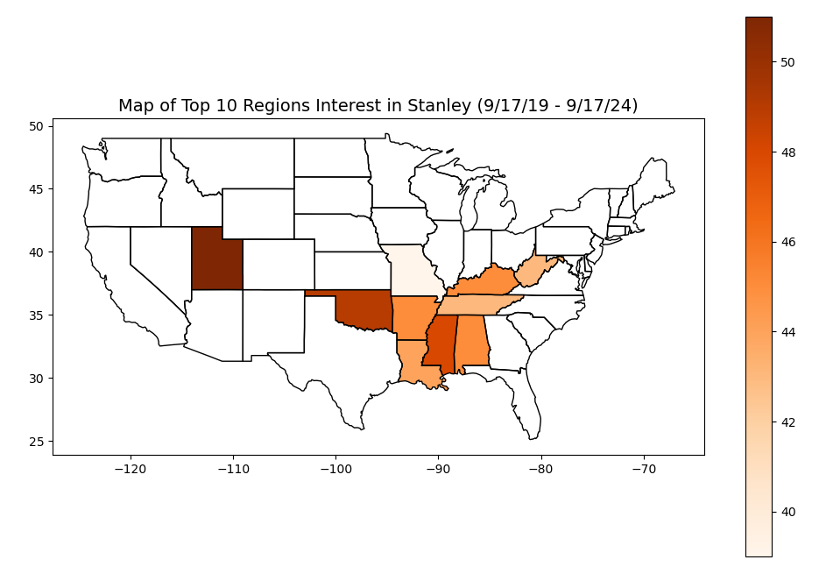
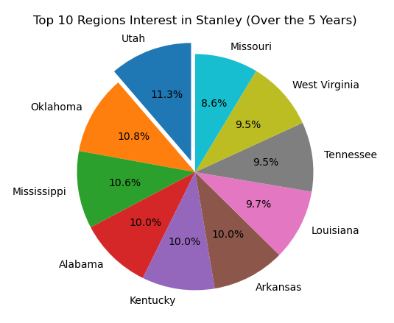
Top 10 Regions - Interested in Stanley (Over the 5 Years)

Slide 13
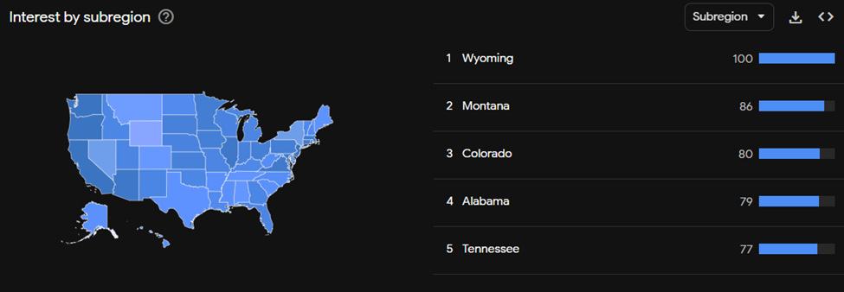
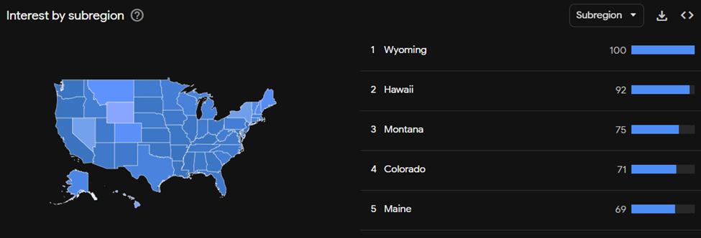
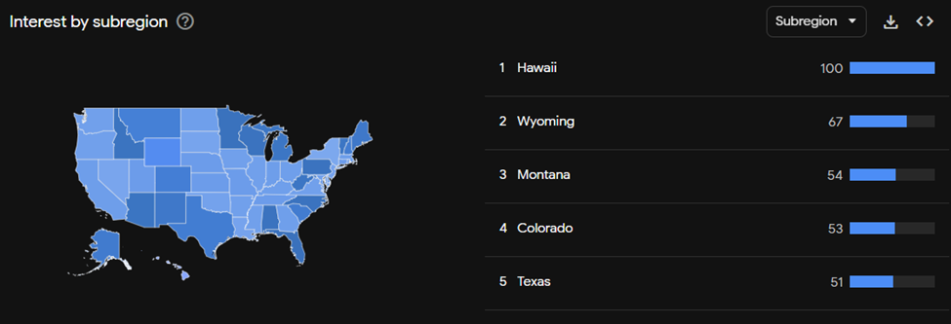
20 years ago
Overview of Yeti Interest
(By Region)
5 years ago
12 months ago

Slide 14
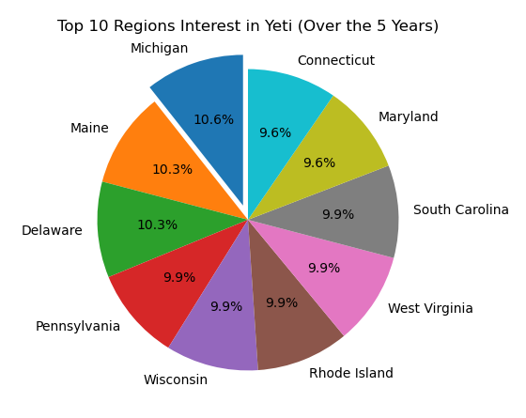
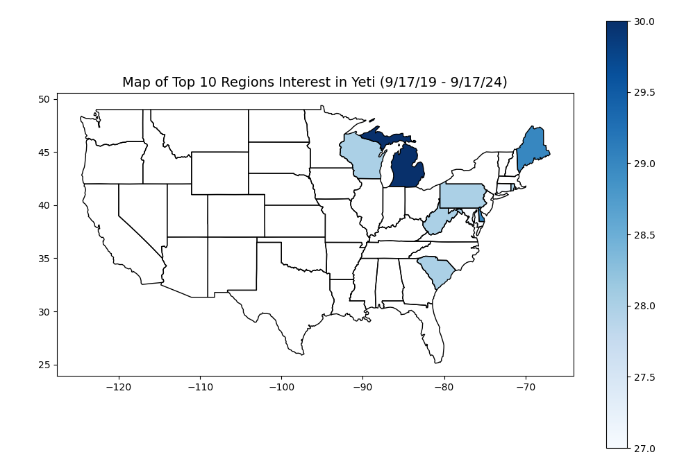
Top 10 Regions - Interested in Yeti (Over the 5 Years)

Slide 15
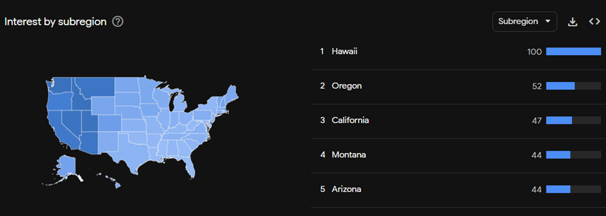
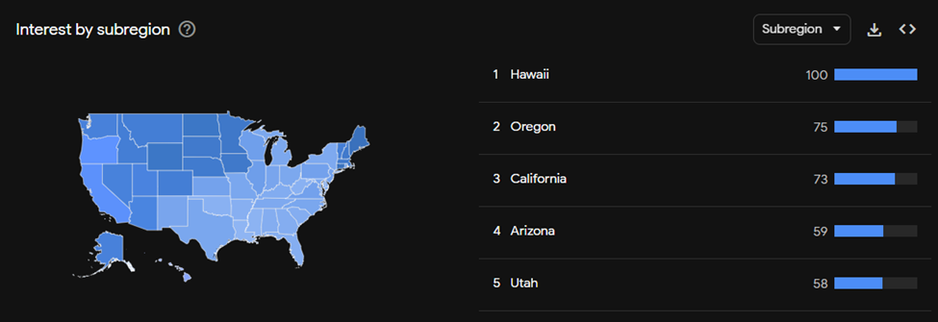
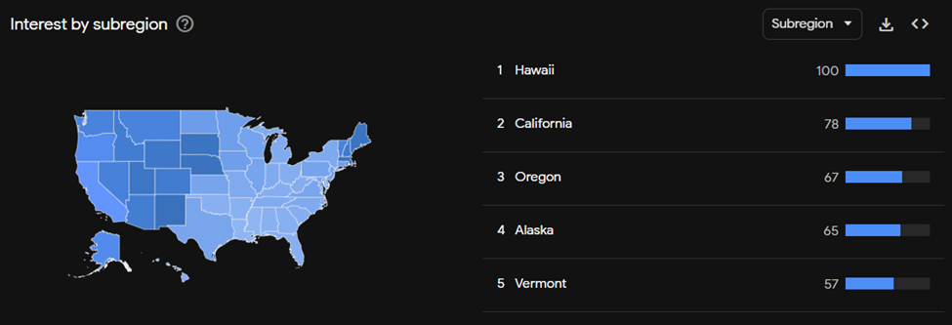
20 years ago
Overview of Hydro Flask Interest
(By Region)
5 years ago
12 months ago

Slide 16
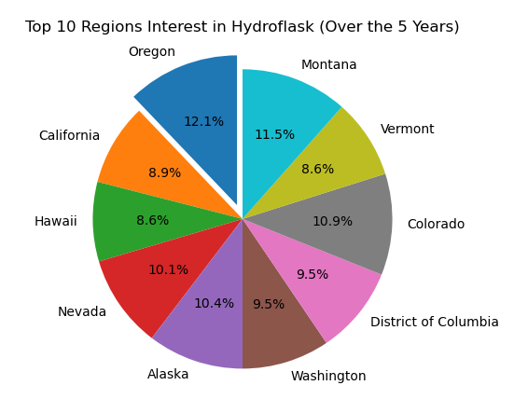
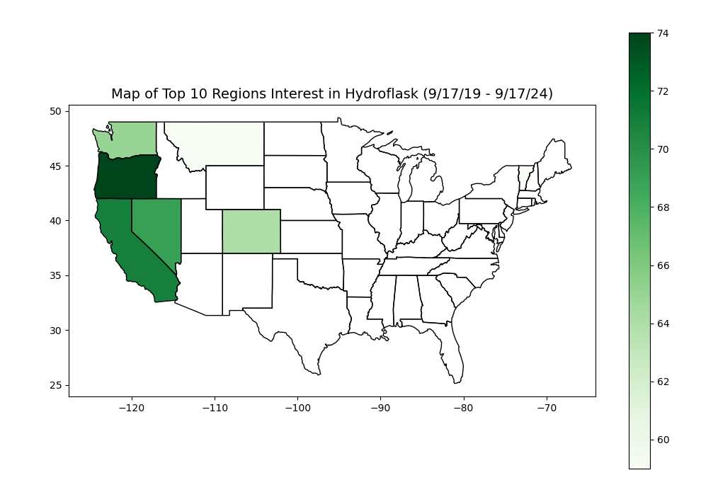
Top 10 Region - Interested in Hydro Flask
(Over the 5 Years)

Slide 17
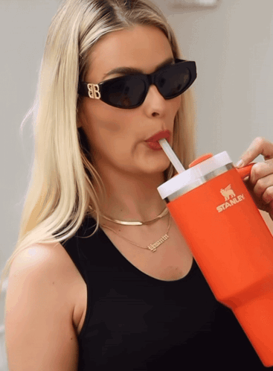
What about after the viral video?

Slide 18
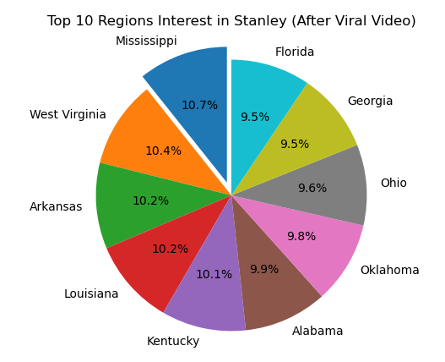
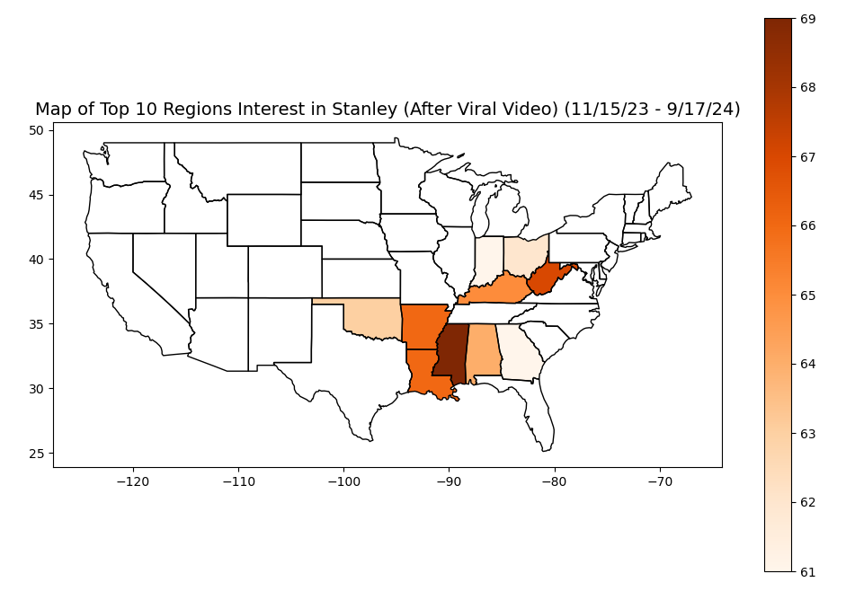
Top 10 Regions - Interested in Stanley (After the Viral Video)

Slide 19
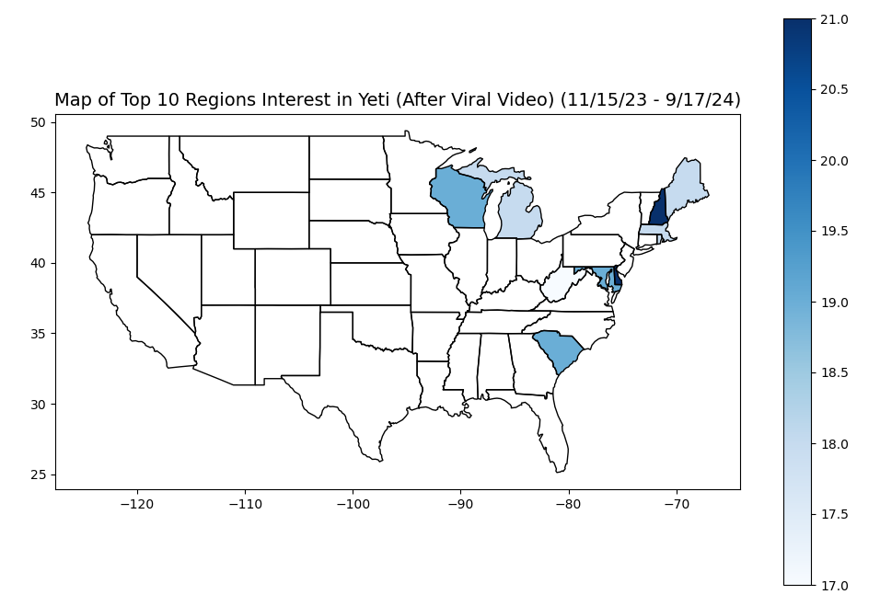
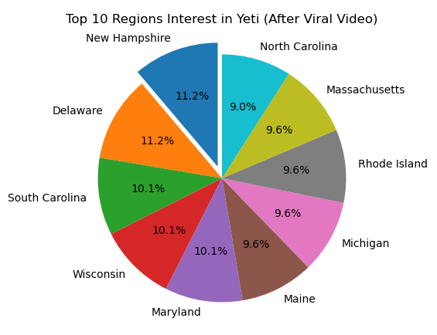
Top 10 Regions - Interested in Yeti (After the Viral Video)

Slide 20
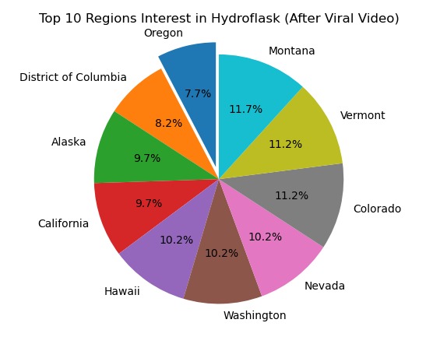
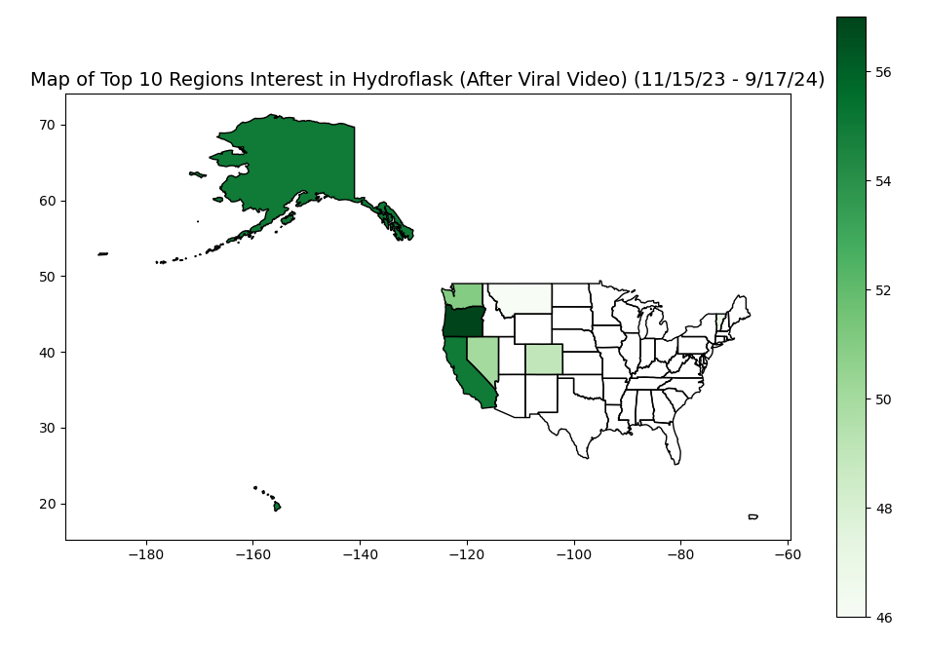
Top 10 Regions - Interested in Hydro Flask
(After the Viral Video)

Slide 21
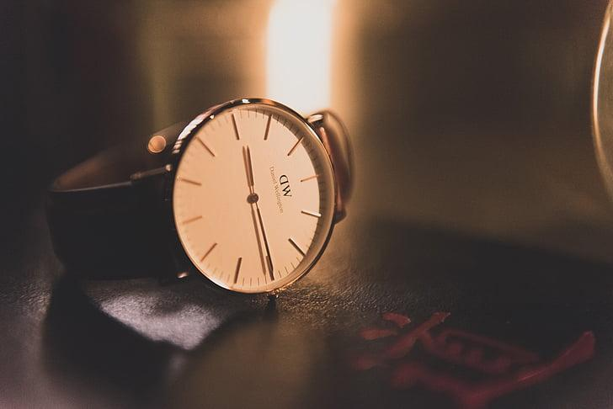
When do people search for Stanley tumbler the most?

Slide 22
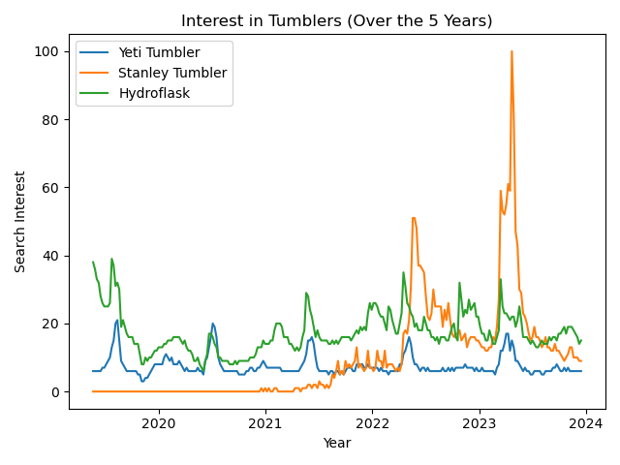

Slide 23
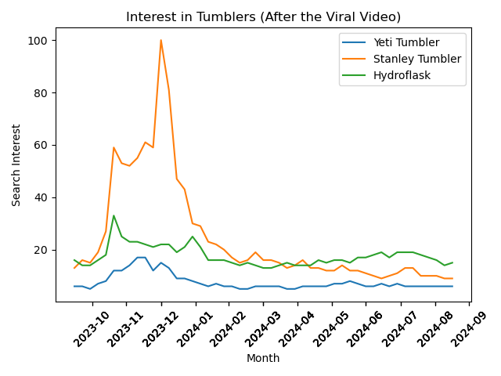

Slide 24
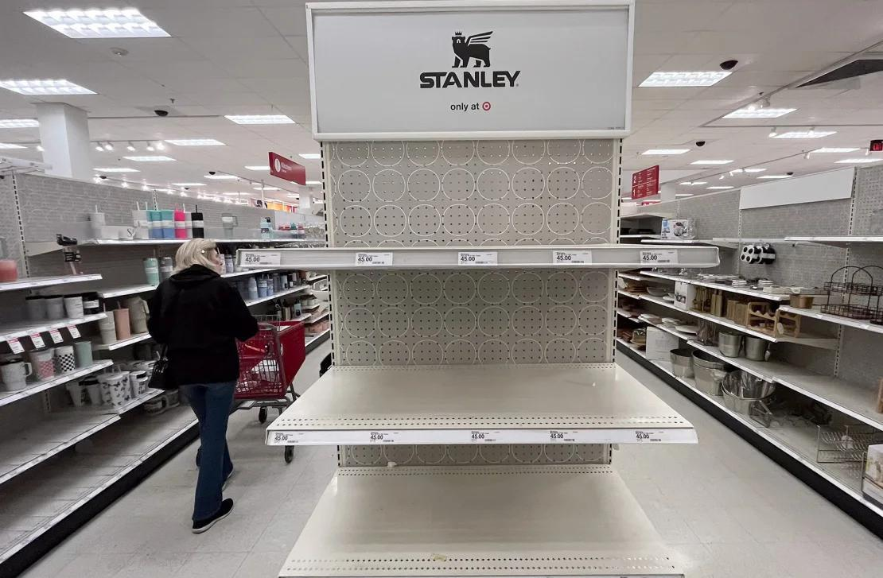

Slide 25
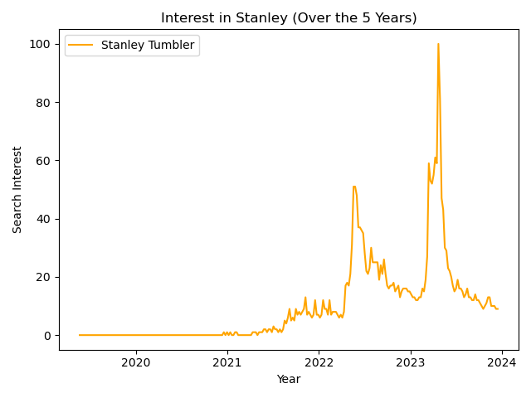
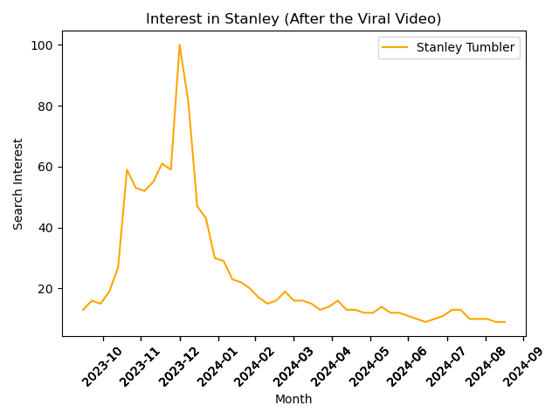
Stanley Under the Scope

Slide 26
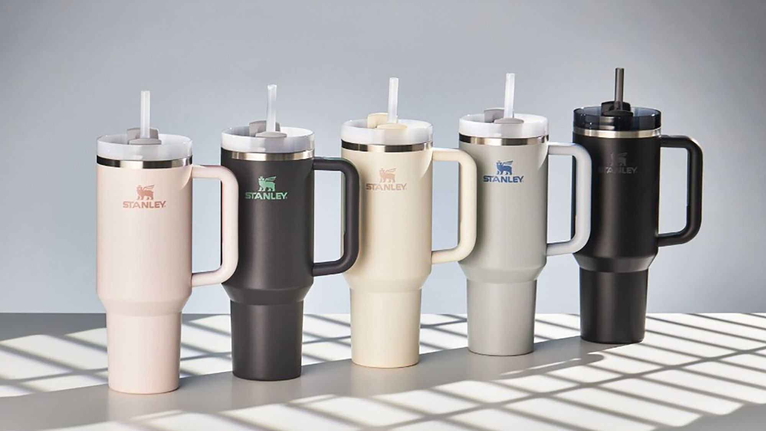
Popularity Between Cream, Charcoal, and Rose-Quartz Based on Ratings/Reviews From Amazon

Slide 27
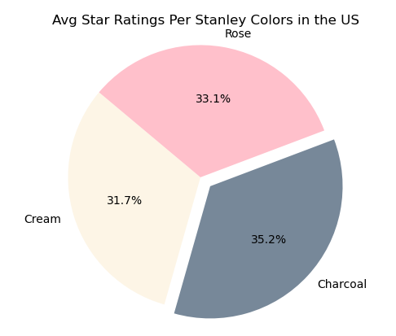
US Market Average Ratings for Cream, Charcoal, Rose Quartz Stanley Tumblers
Rose Average US rating =
3.5 stars out of 5
Cream Average US rating =
3.3 stars out of 5
Charcoal Average US rating =
3.7 stars out of 5
Notes:
*Change the green for Rose to a pink color then change the orange for Charcoal to gray color and then change the blue for Cream to a yellow color.

Slide 28
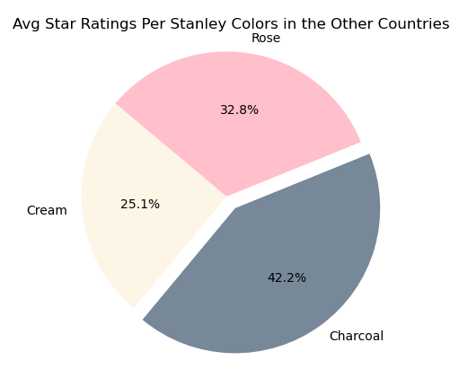
International Market Average Ratings for Cream, Charcoal, Rose Quartz Stanley Tumblers
Rose Average International rating =
3.2 stars out of 5
Cream Average International rating =
2.4 stars out of 5
Charcoal Average International rating =
4.1 stars out of 5
Notes:
Change colors to correspond w/previous slide and product

Slide 29
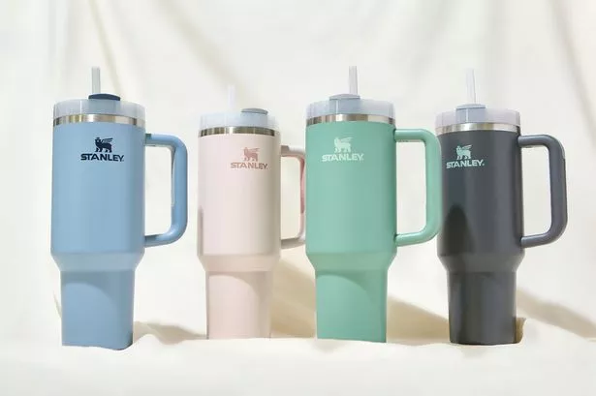
How can Stanley optimize its marketing strategies, enhance product offerings, and ultimately drive sales growth?

Slide 30
References
1. Viral video posted 11/15/23 username: @danimarielettering with 96.9m views, Sept 18th, 2023
2. ABC7 News YouTube account “New Stanley cups spark chaos at Target, selling out in minutes” - 294,664 views posted Jan 4, 2024
3. https://youtu.be/xTn8s_EBCqw?si=_DweNX90JON0RbFc, Man seen jumping over the counter in an attempt to steal a Stanley x Starbucks Tumbler, Jan 3rd, 2024
4. ABC7 News: https://youtu.be/zAvyoTBox5g?si=5aMzCqRMZZCwqRvI
5. Forbes.com, “Stanley Cup Craze Floods TikTok Feeds, Raises $750 Million In Revenue”, Jan 5th, 2024
6. CNBC.com, “How a 40-ounce cup turned Stanley into a $750 million a year business”, Dec 23rd, 2024
7. https://www.cnn.com/2024/01/26/health/stanley-cups-lead-wellness/index.html - CNN, Jan 26th, 2024
8. Today Show: https://www.today.com/food/trends/stanley-cup-craze-rcna132901, Jan 9th, 2024
9.Reuters:https://www.reuters.com/legal/litigation/stanley-cup-lawsuits-over-lead-fail-claim-harm-company-says-2024-08-01/, Aug 1st, 2024

